Slide 1
HotpotQA
Finding and reasoning over multiple supporting documents
Sentence-level supporting facts required for reasoning
Factoid comparison questions
Not constrained to any pre-existing knowledge bases or knowledge schemas

Slide 2
Coreference Resolution??
Input
(Corpus)
Stemming / Lemmatization
Tokenization and Lower casing
Stop words removal
Vectorization
Positional
Encoding
Split the sentence into words and convert each word to lower case.
Stop words are very commonly used words (a, an, the, etc.) in the documents.

Slide 3
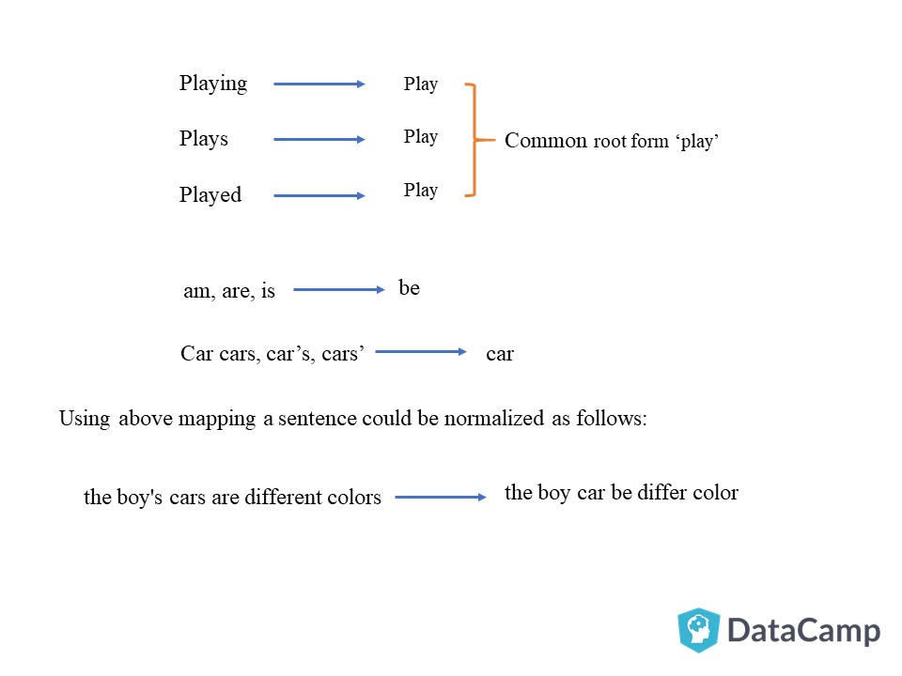
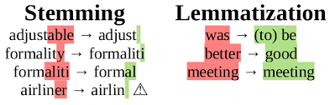
Stemming and Lemmatization
Stemming | Lemmatization
It is a process of transforming a word to its root form. However the root may not be a valid English word. | Unlike stemming, lemmatization reduces the words to a root word existing in the language.
Stemming work by slicing the end or the beginning of the word, using a list of common prefixes and suffixes like (-ing, -ed, -es). This slicing can be successful on most occasions, but not always | Lemmatization takes help of the linguistic analysis of the words. It is necessary to have detailed dictionaries which the algorithm can look through to link the form back to its lemma. It takes help of various linguistic insights of that particular word.

Slide 4
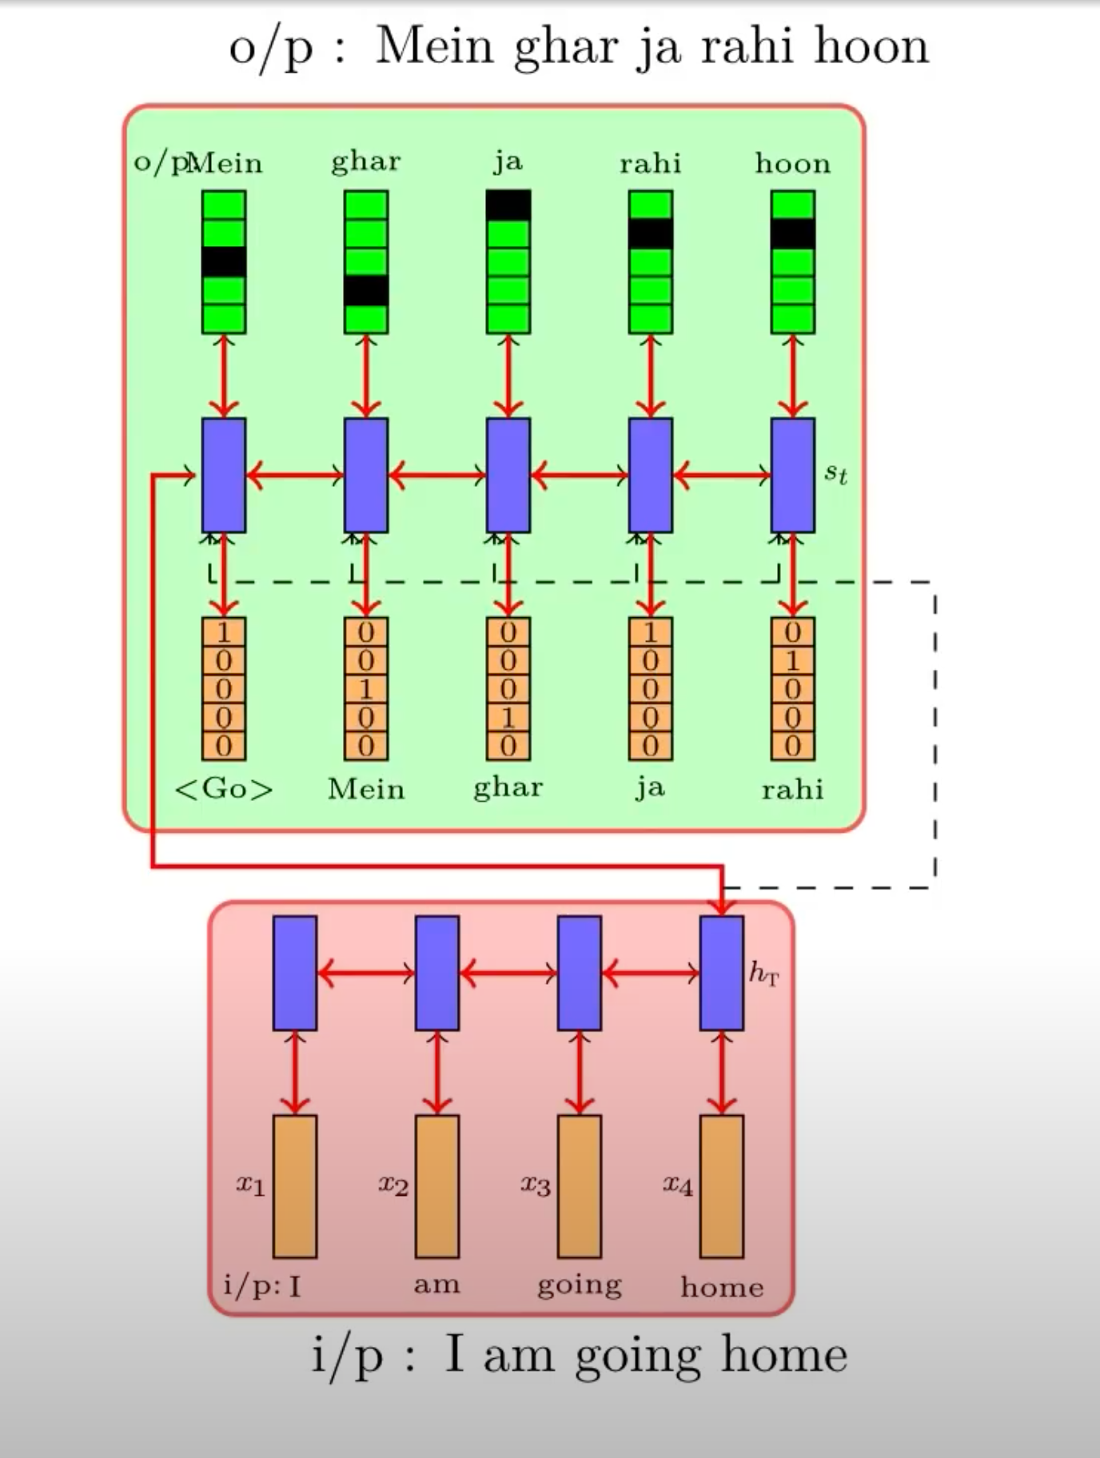
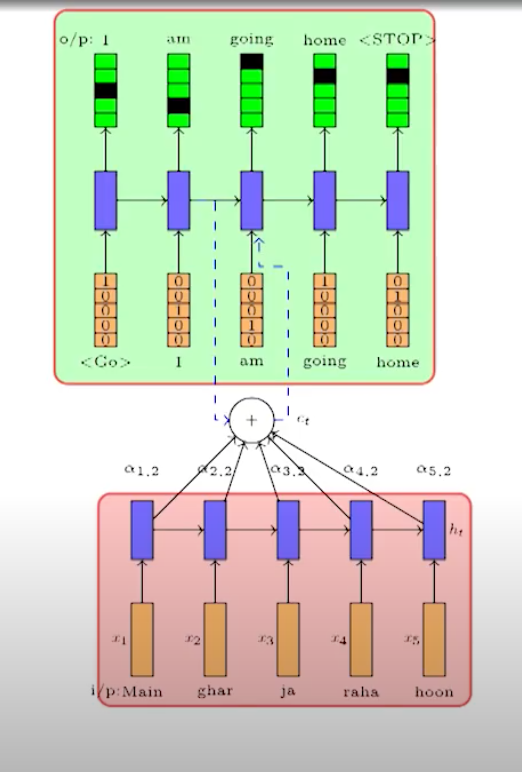
Encoder – Decoder Model (Translation Example)

Slide 5
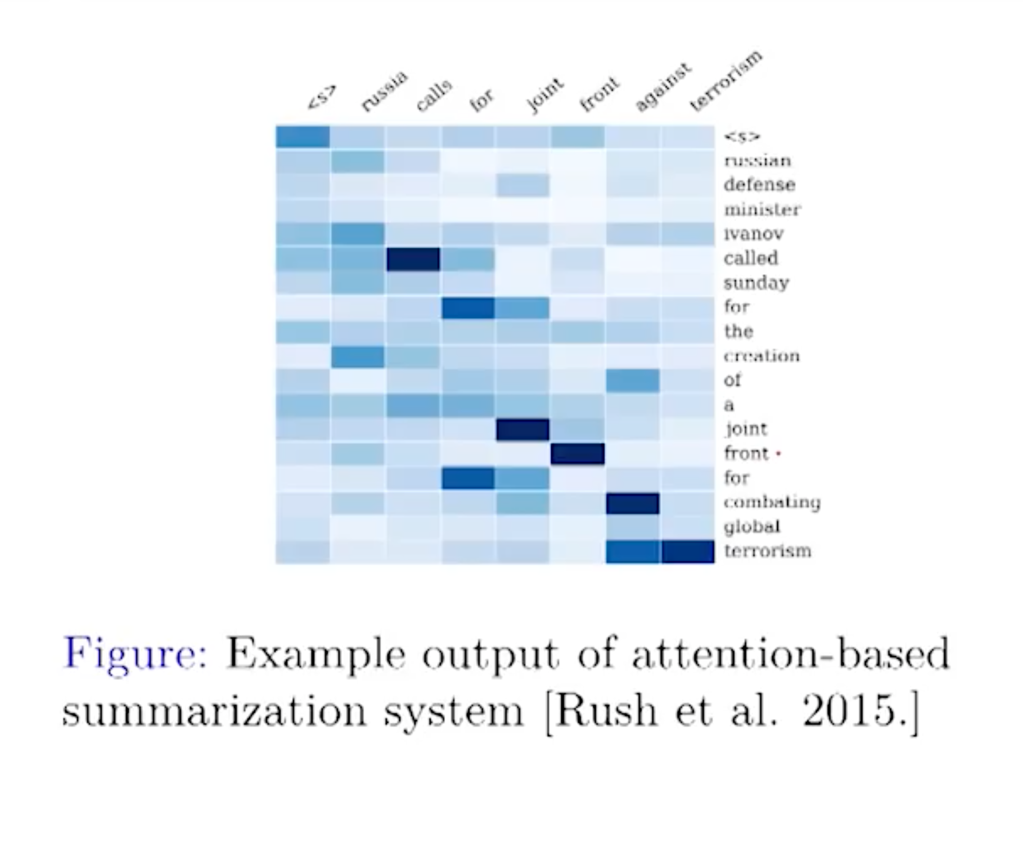
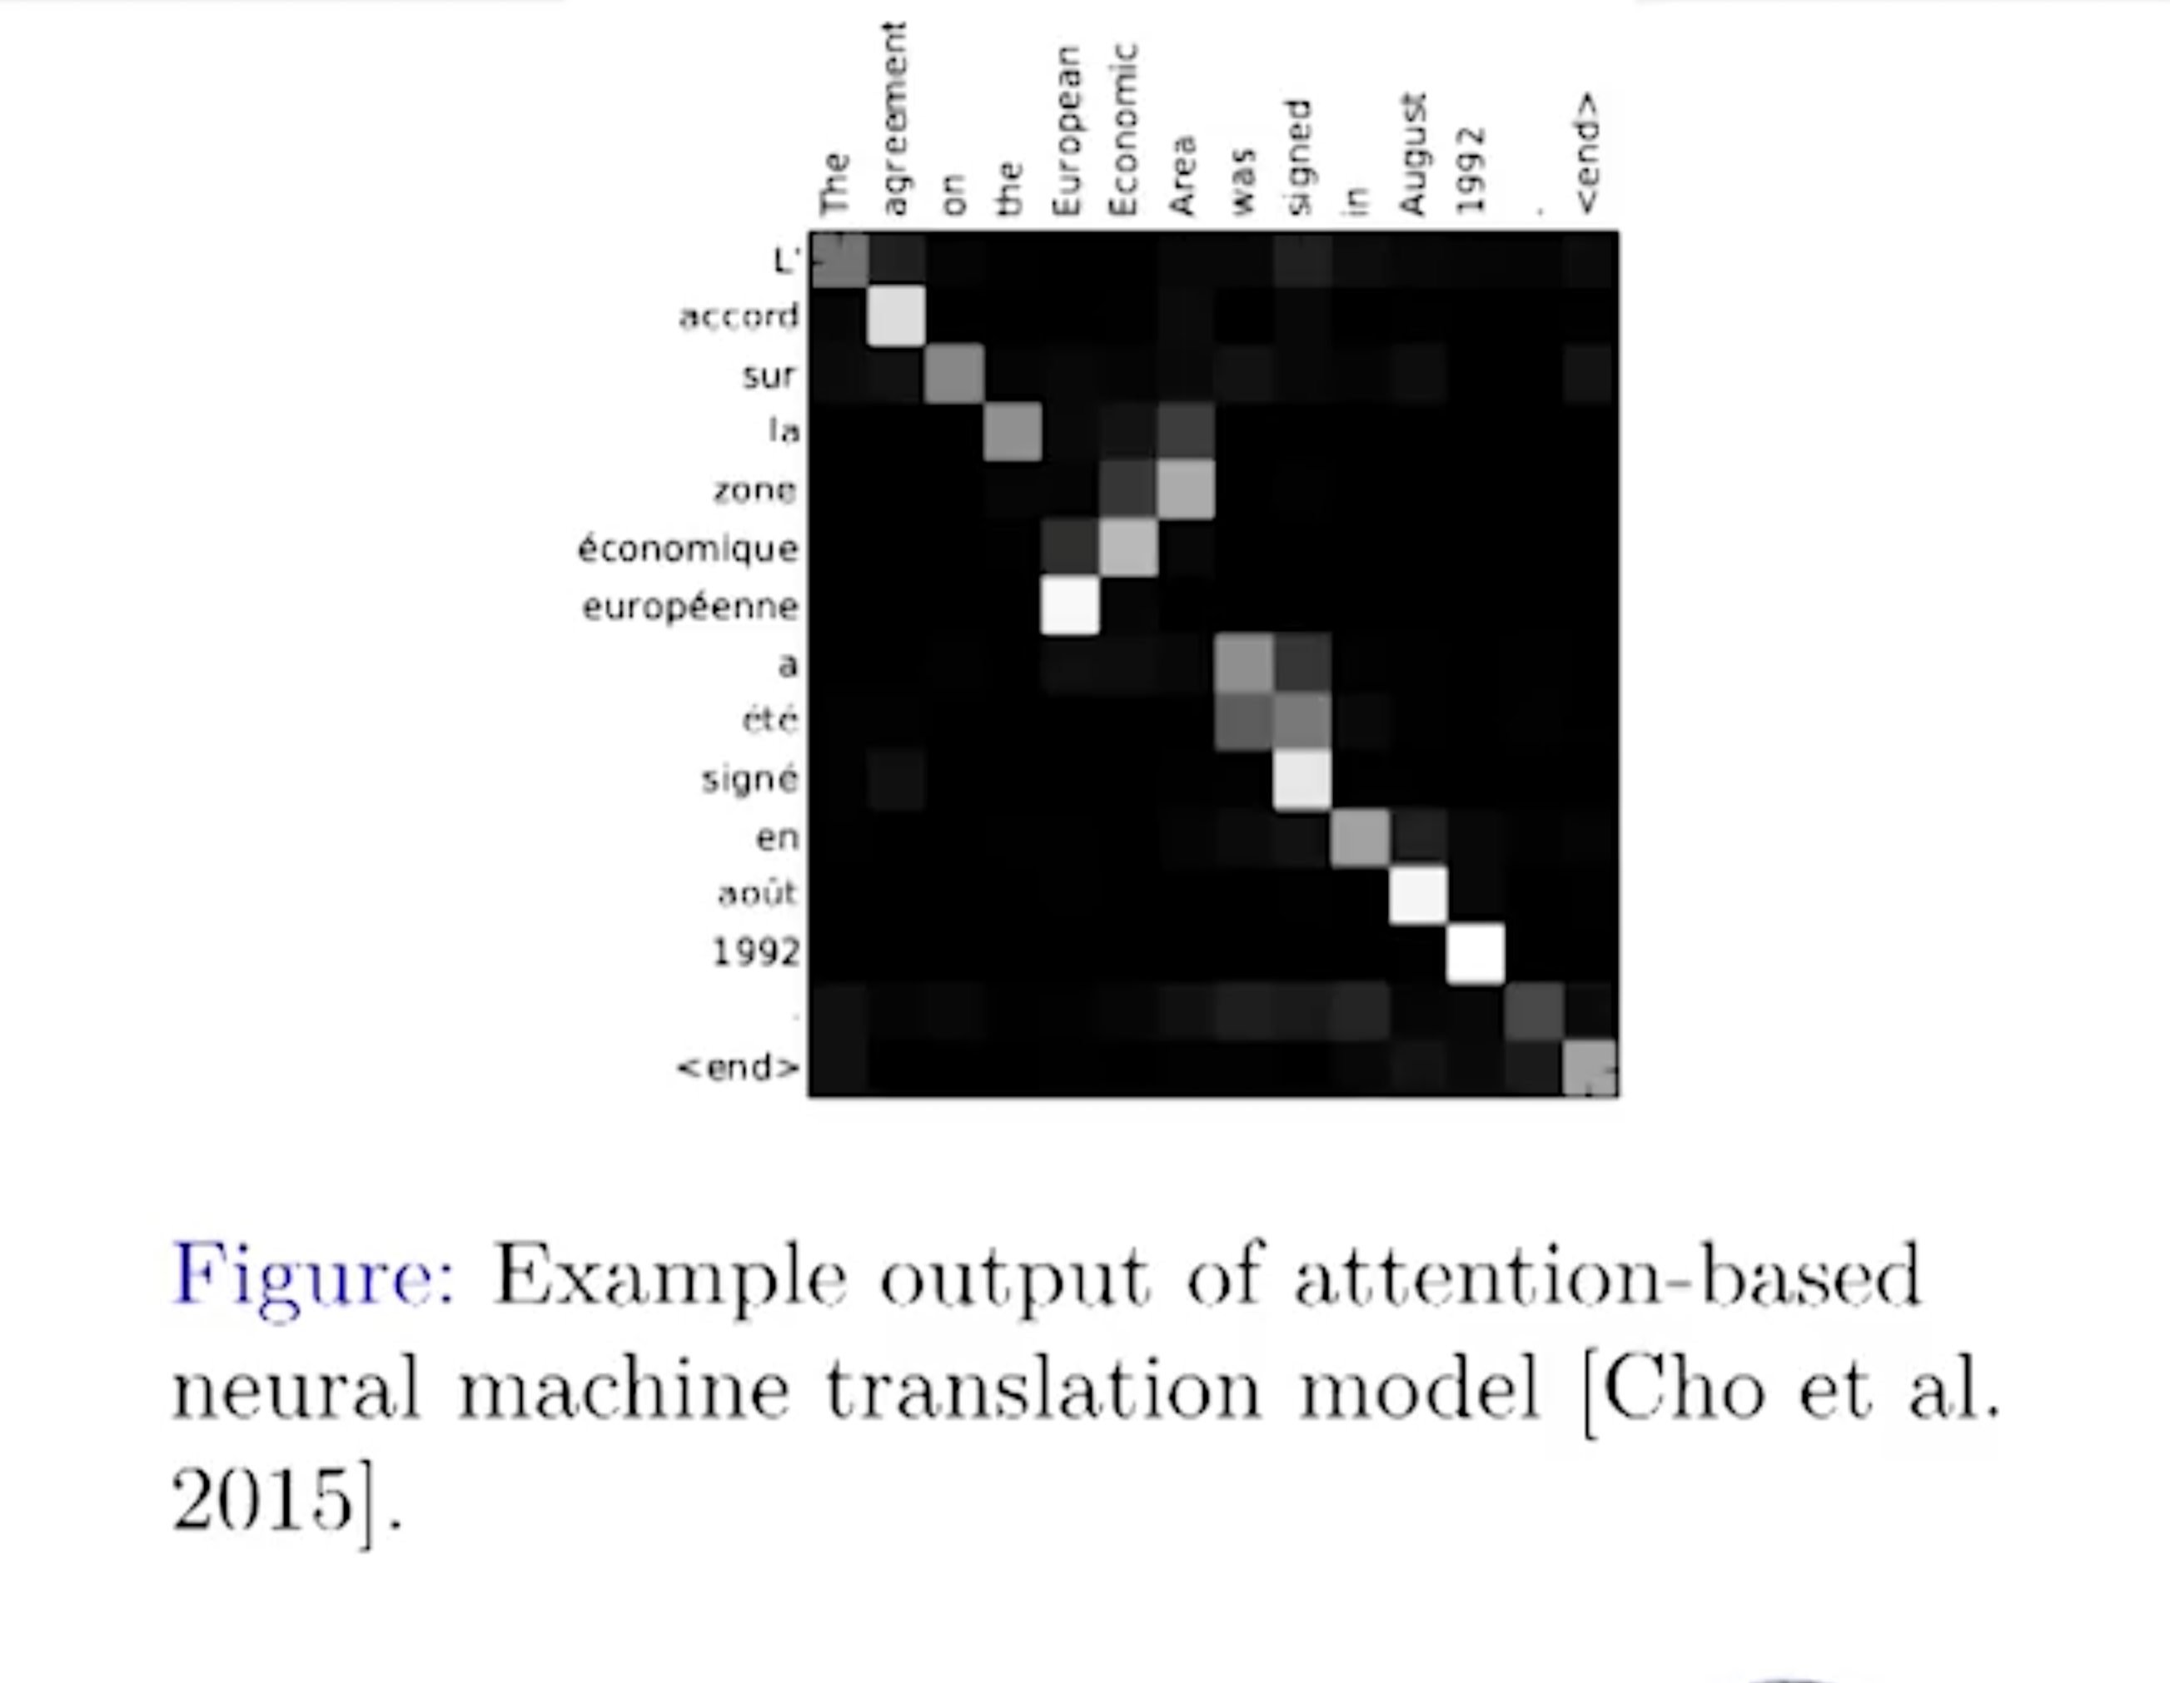
Attention Mechanism

Slide 6
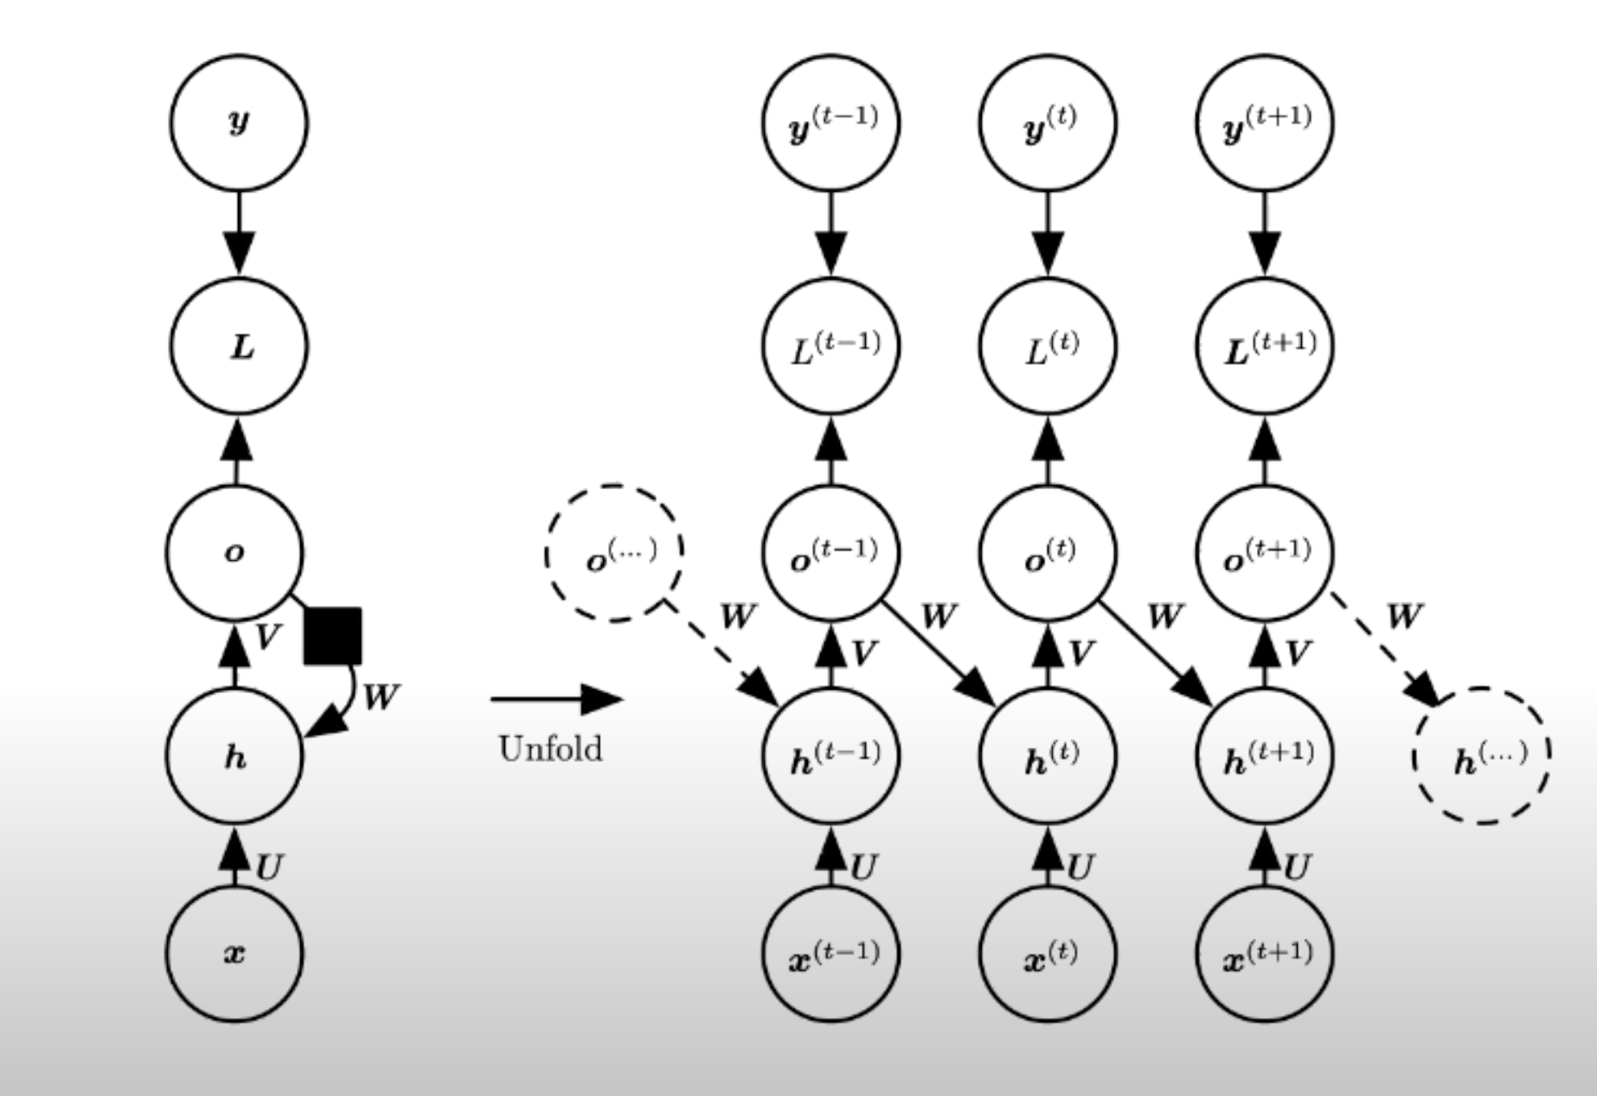
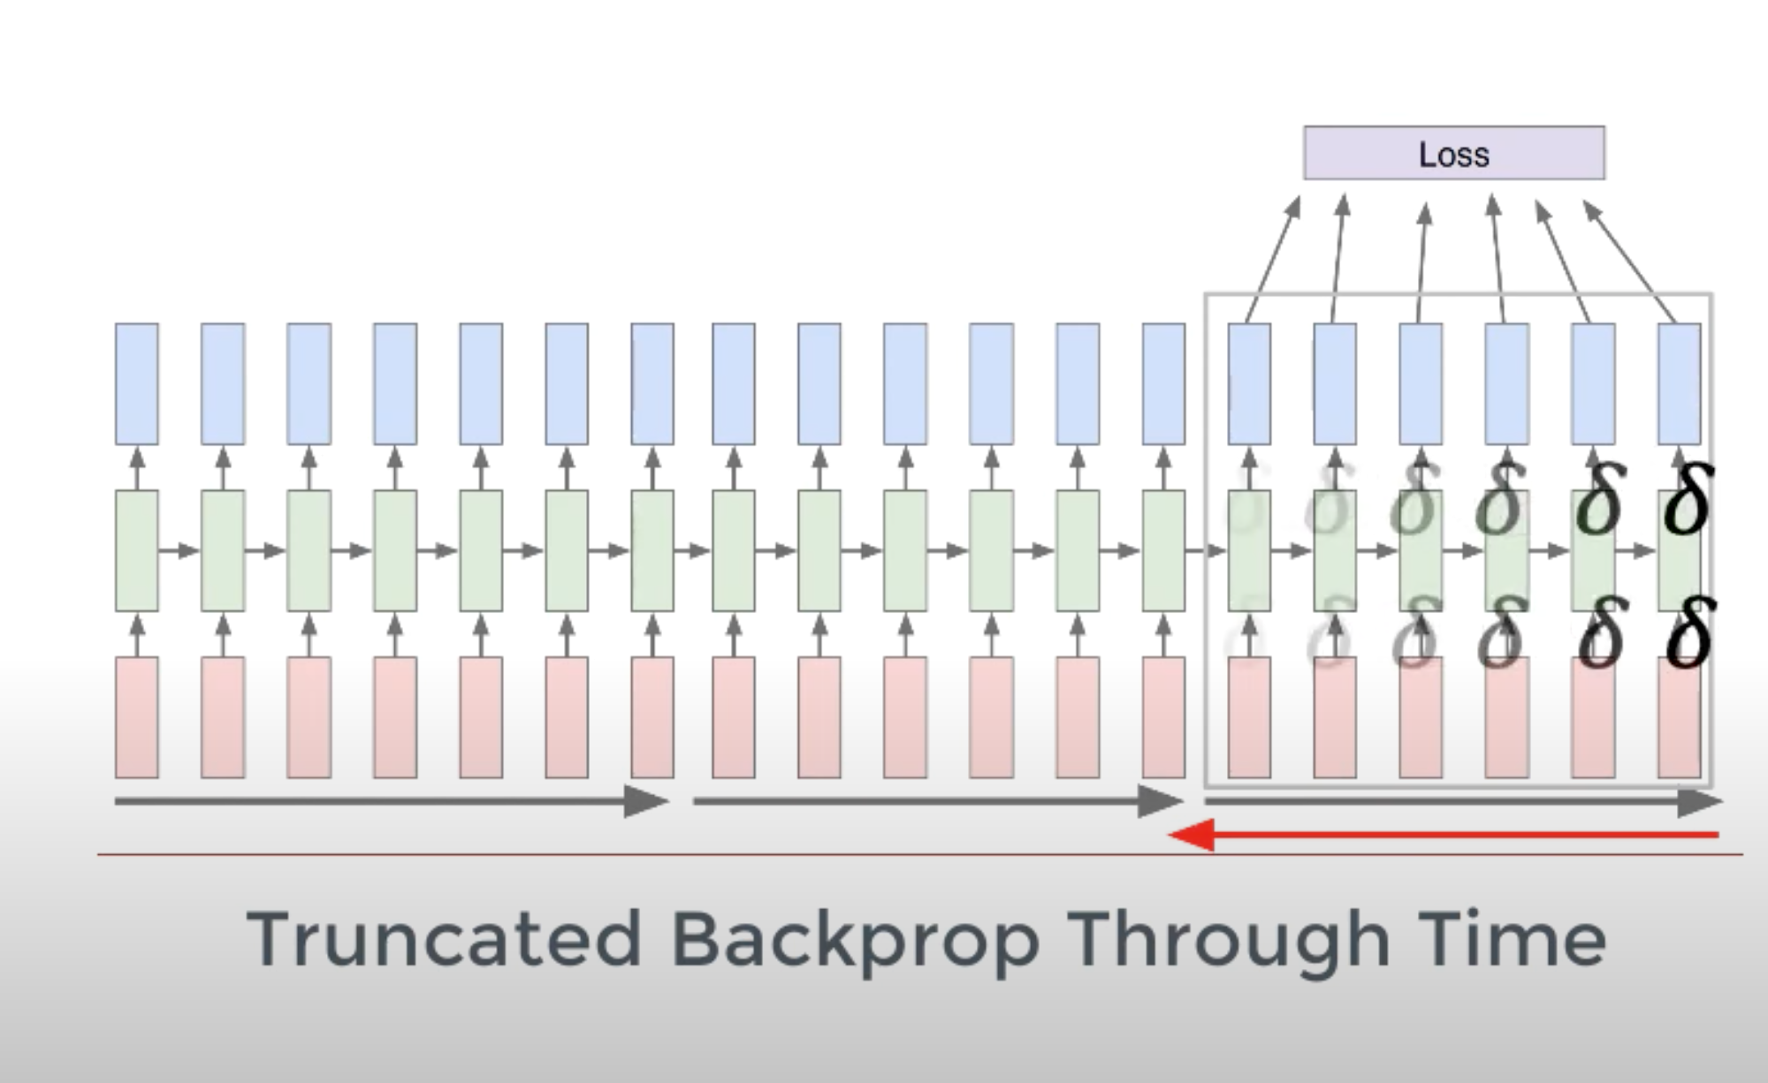
RNN
Advantages
Used to deal with sequential data
Input can have a variable size
Disadvantages
Slow to train
Long sequences lead to Vanishing/ Exploding gradient
Input at each state is the output of previous state and next input word thus we can encapsulate the notion of context to some extent

Slide 7
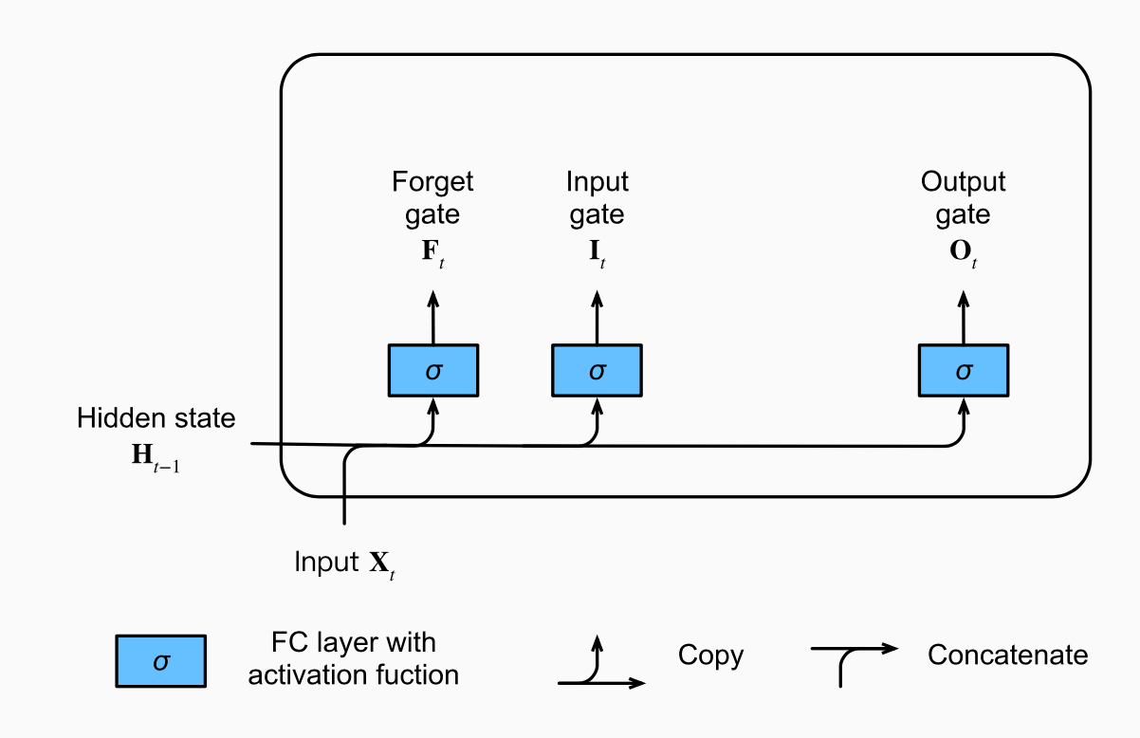
LSTM
LSTM solves the problem of vanishing gradient by replacing the naive neurons with a memory cell which consists of 3 gates. Thus allowing only the relevant information to pass through the successive layers.
LSTM
Input Gate
Forget Gate
Output Gate

Slide 8
Transformer Model
LSTM
LSTMs are even slower than RNN.
Don’t make use of parallelization since input is given sequentially.
Transformer
In case of transformer model all the data can be passed at the same time.
Transformers are divided into 2 separate sections namely encoder and decoder which have meaning even in isolation.
The encoder part analyses the input sequence and uses it to understand language and context in general.
Answers in case of QnA system.
Sentences in different language in case of language translation etc.
The output of the encoder can then be fed to the decoder block which can generate the desired output.
Hard to encode the notion of context since they aren’t truly bidirectional

Slide 9

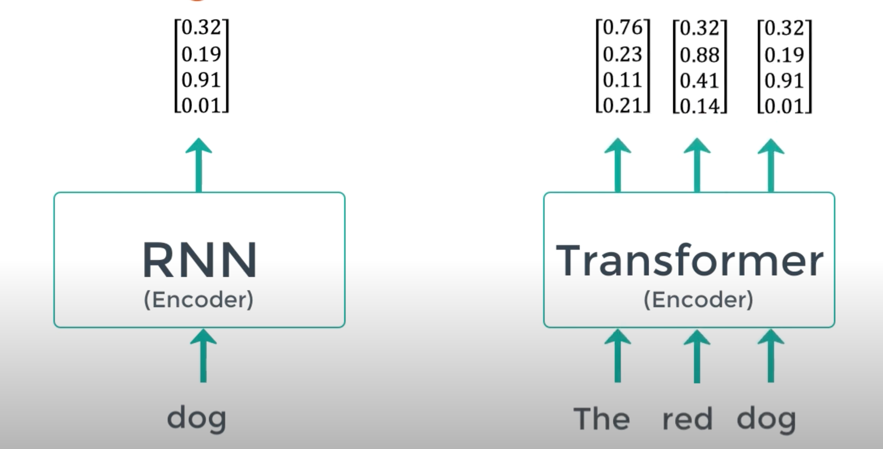

Slide 10
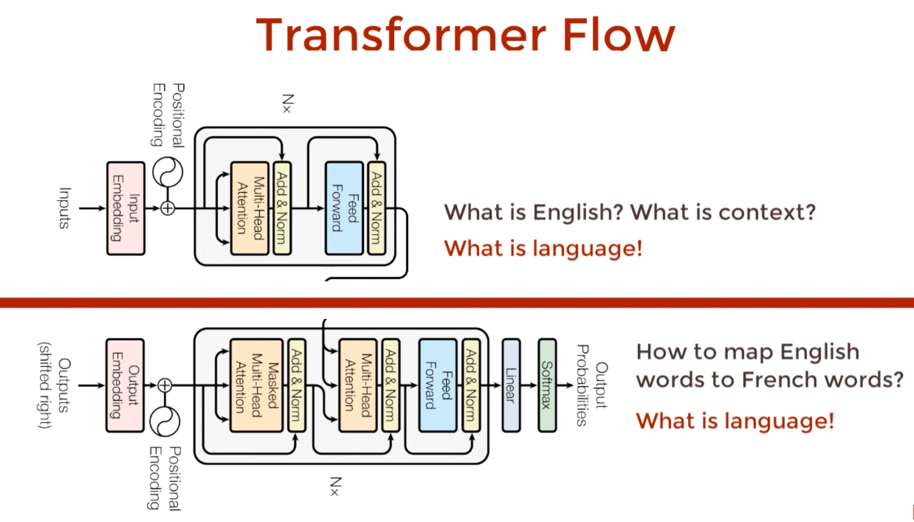
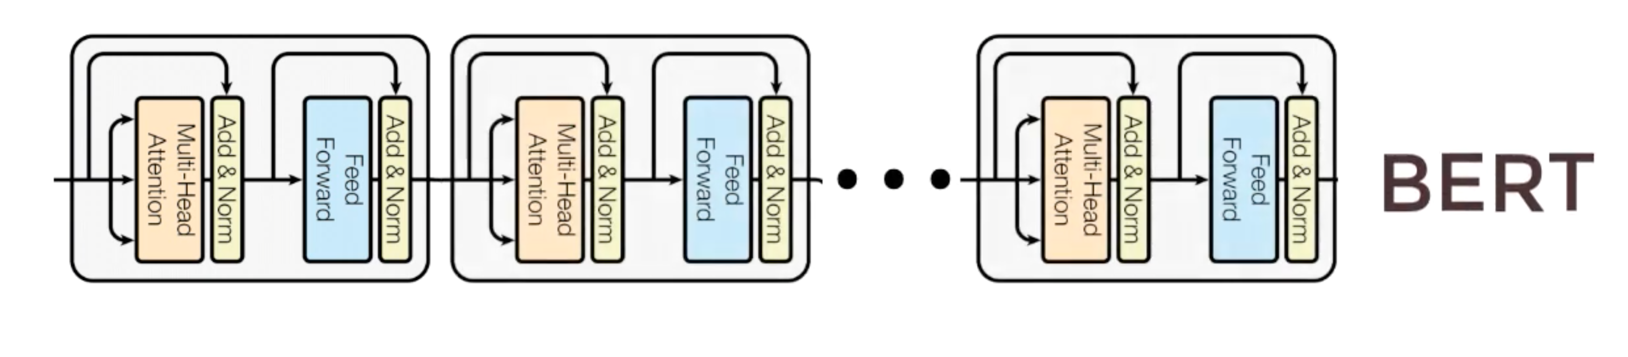
BERT
BERT is formed by stacking the encoder part of a transformer
https://www.youtube.com/watch?v=xI0HHN5XKDo

Slide 11
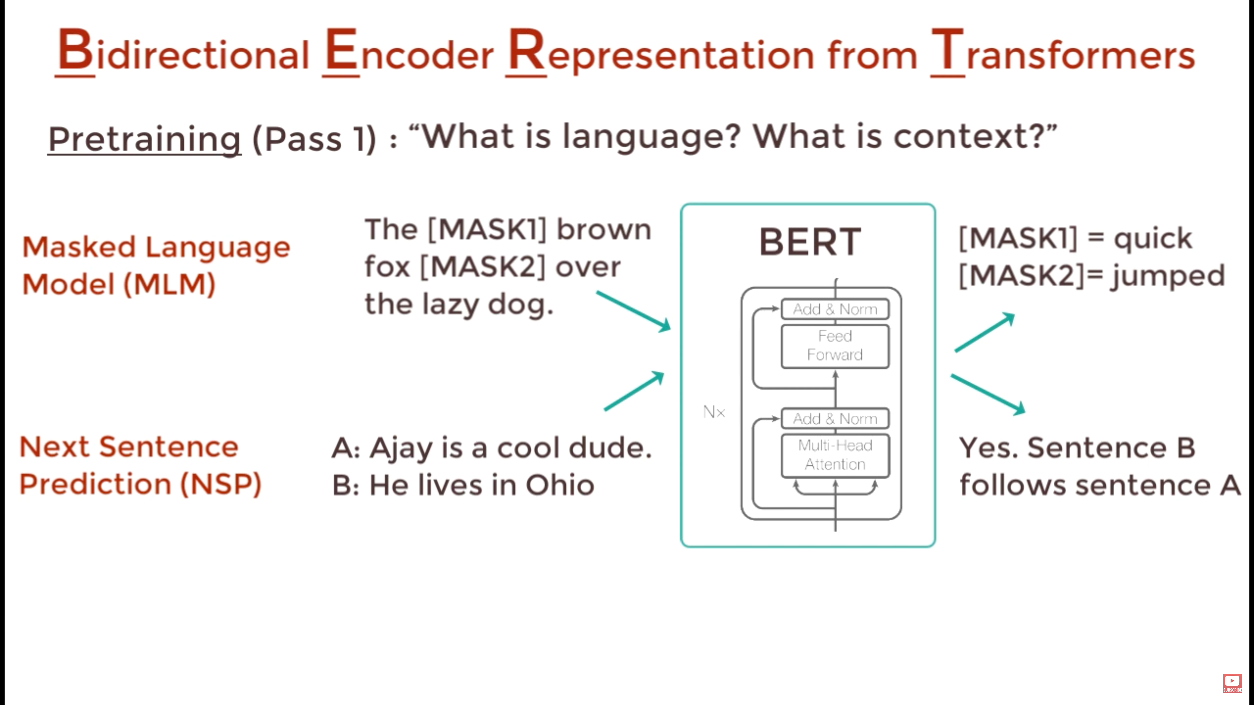
Pretraining
Bert learns using MLM and NSP:
MLM :
MLM is like fill in the blanks
It helps bert understand bidirectional context.
NSP:
NSP is like a binary classification
It helps bert understand context over multiple sentences

Slide 12
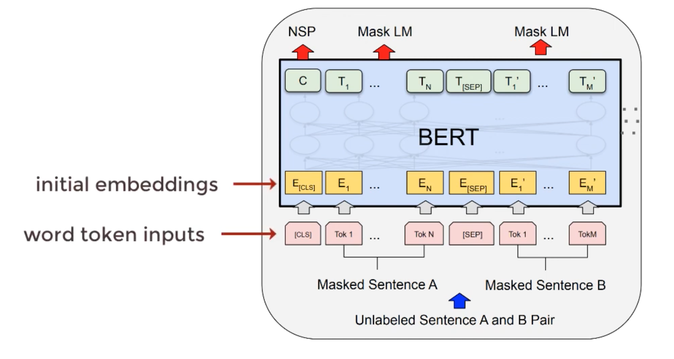
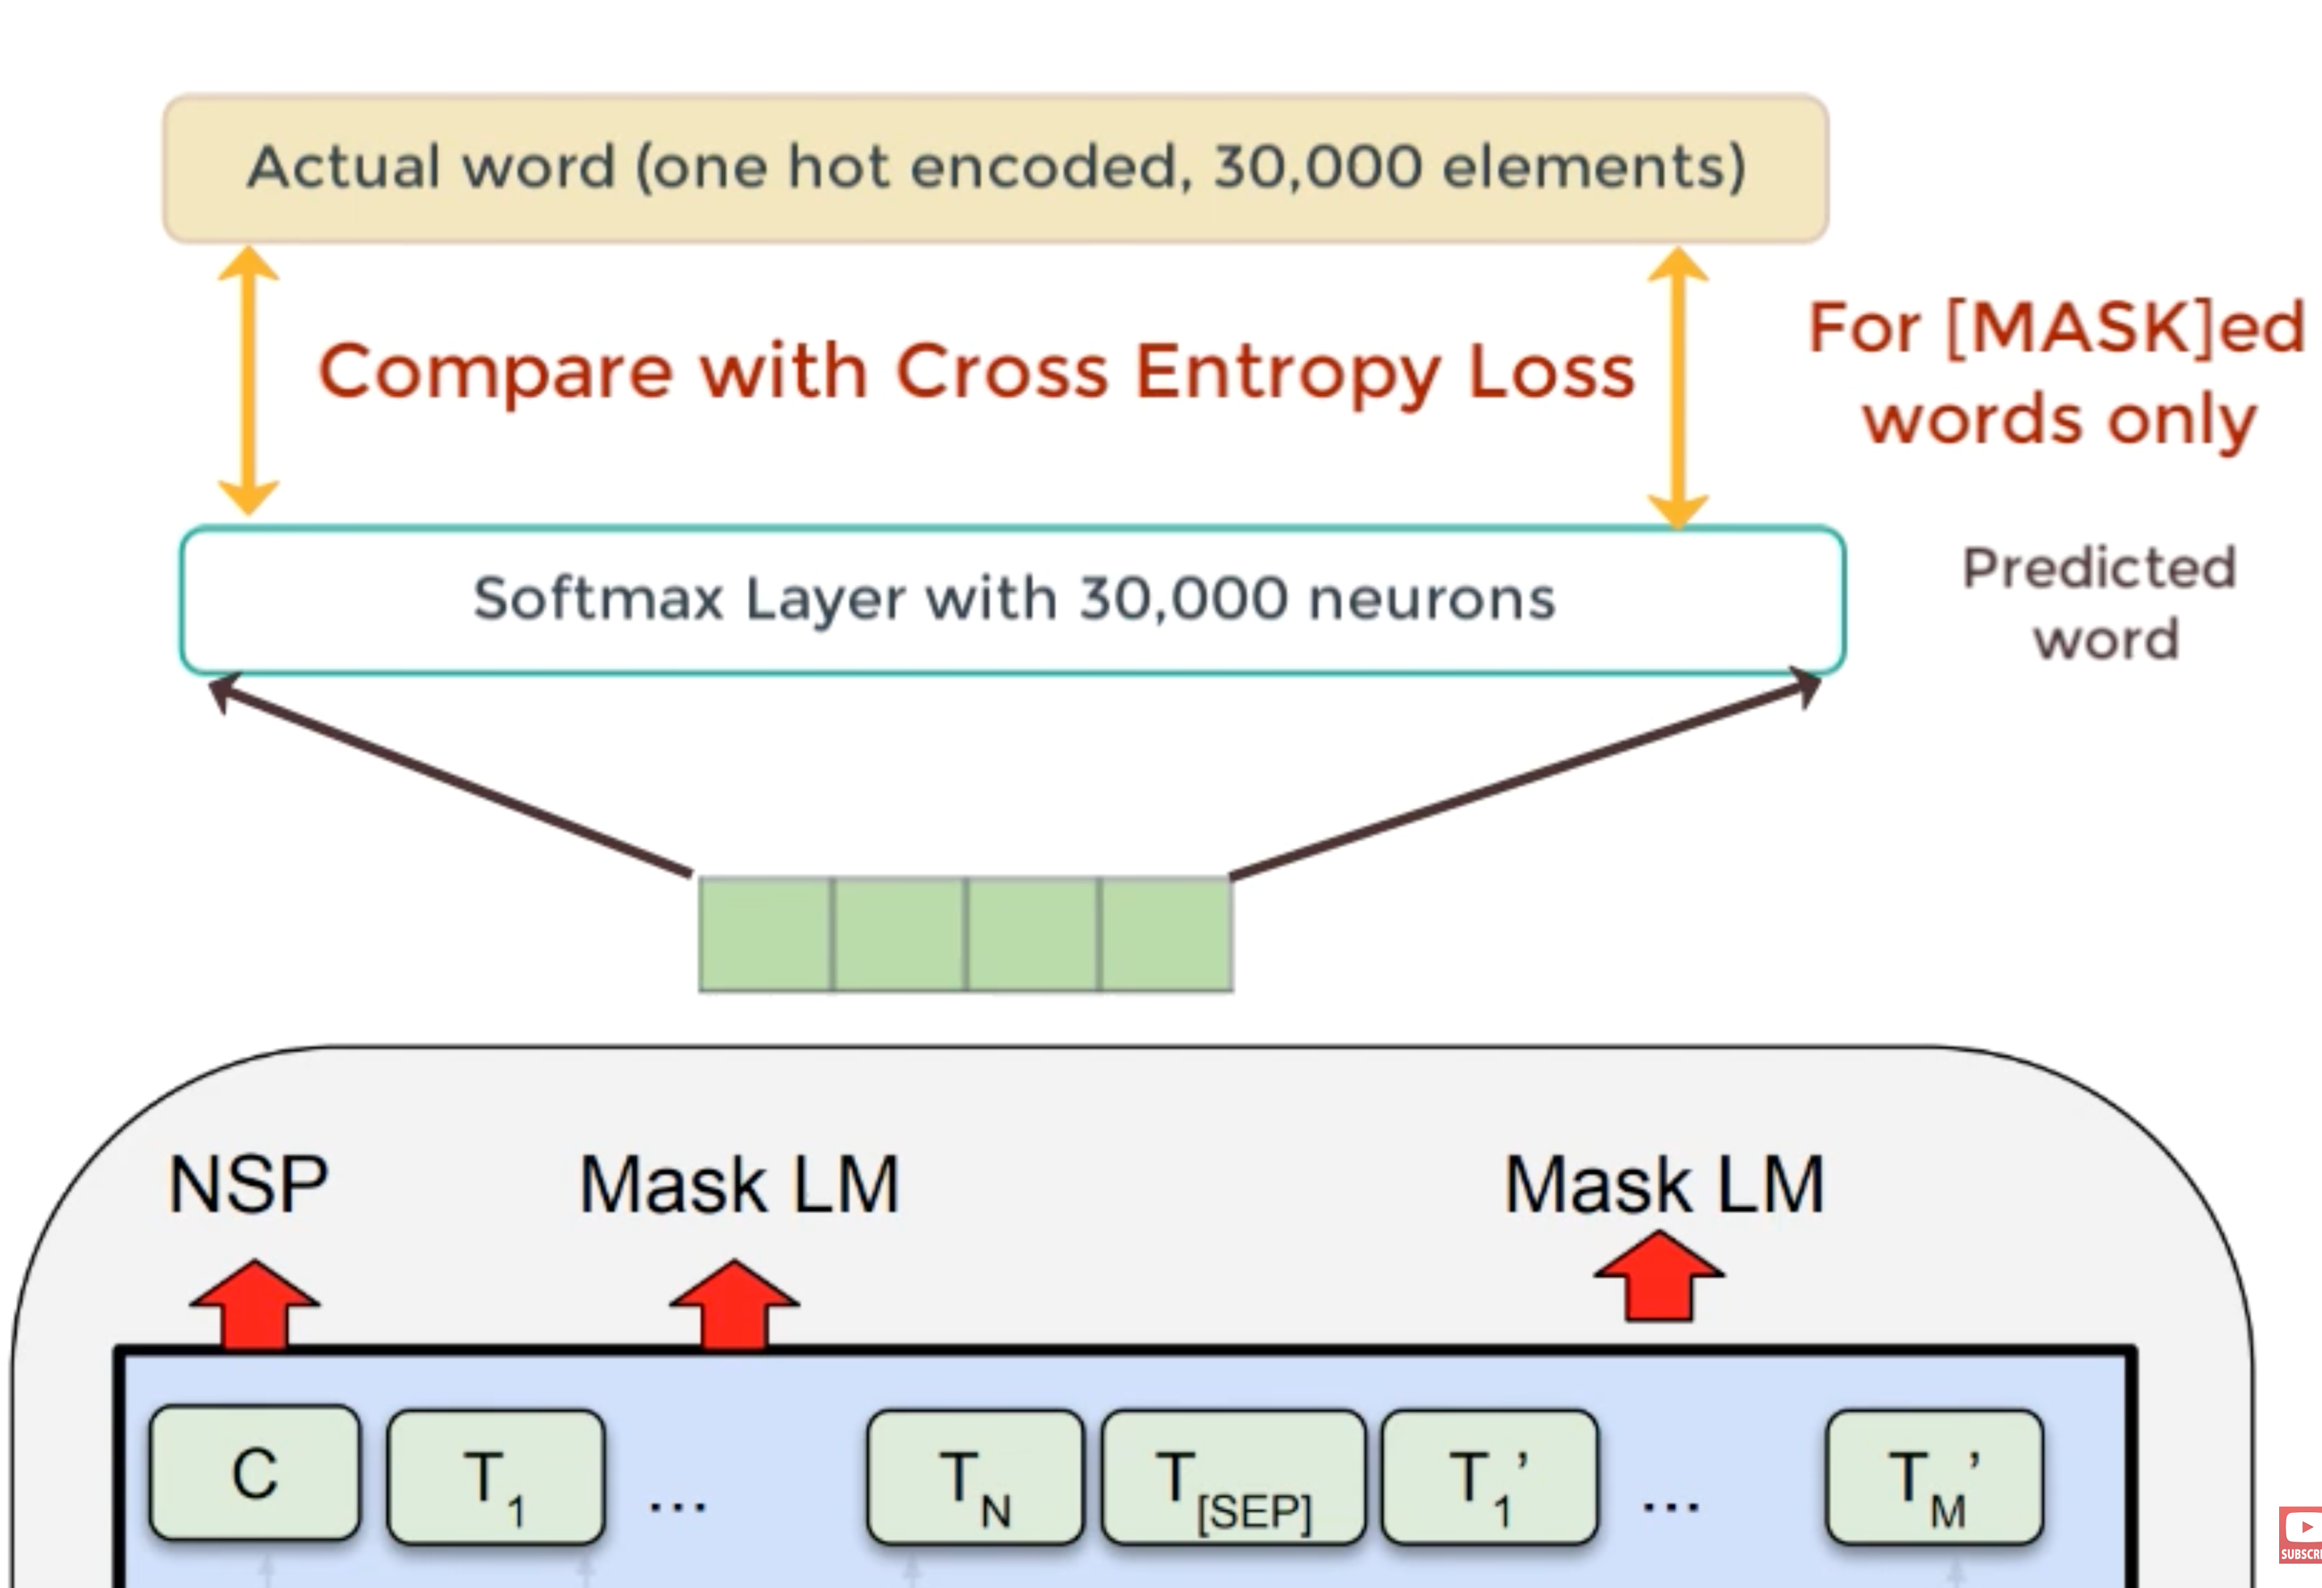
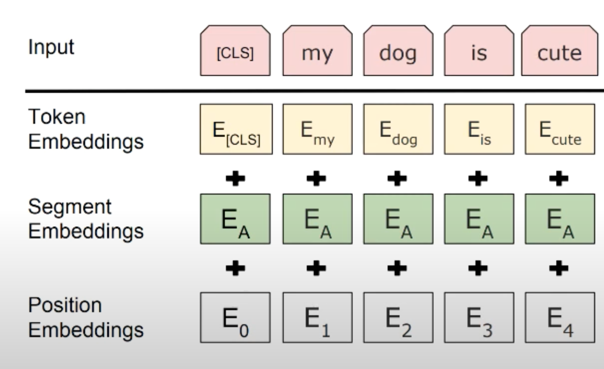

Slide 13
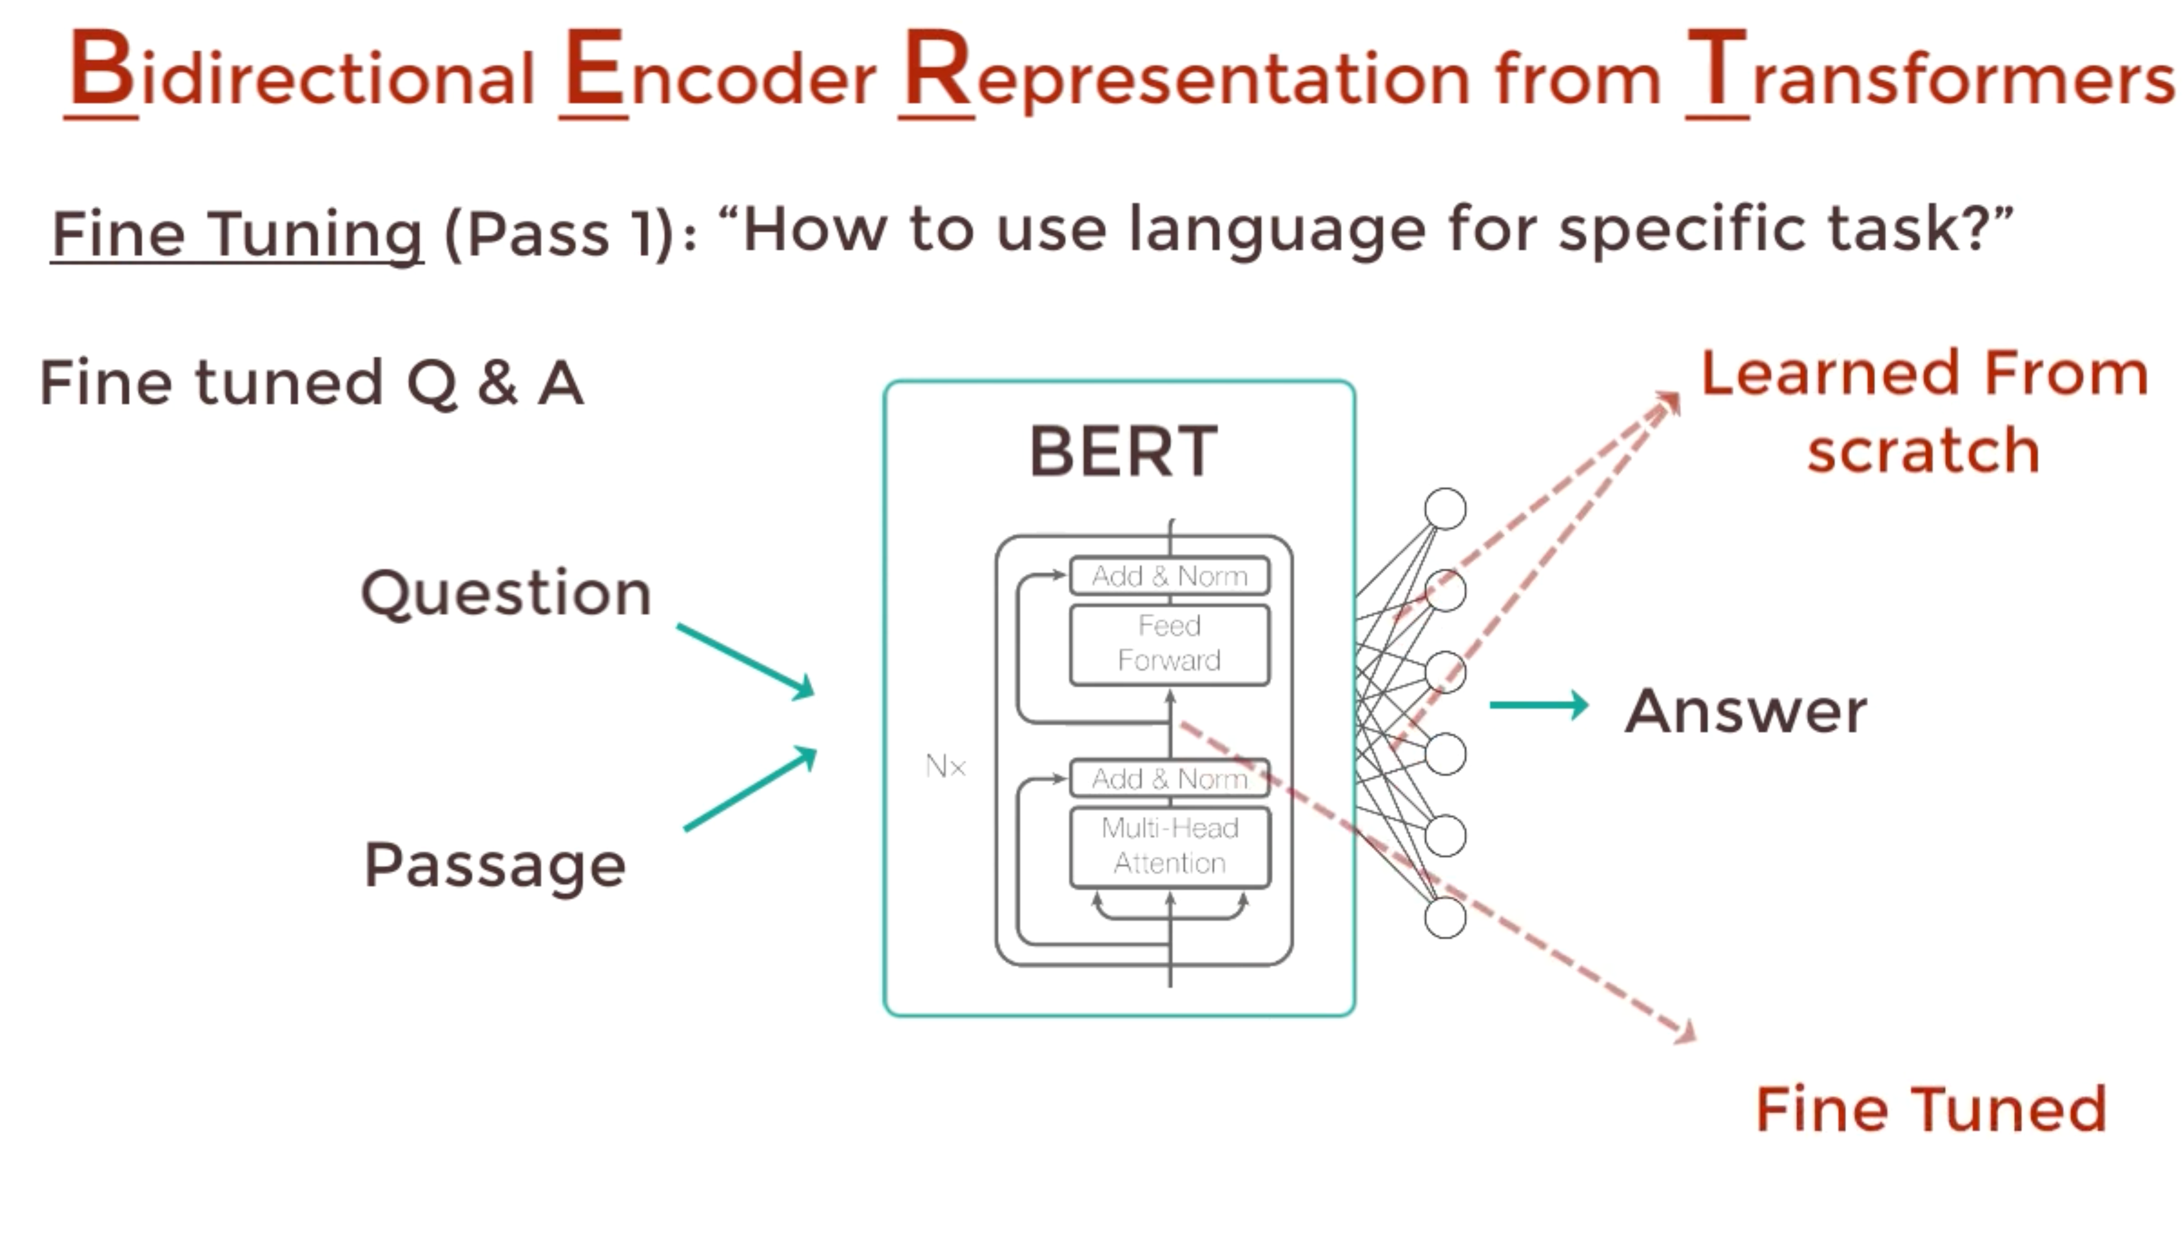
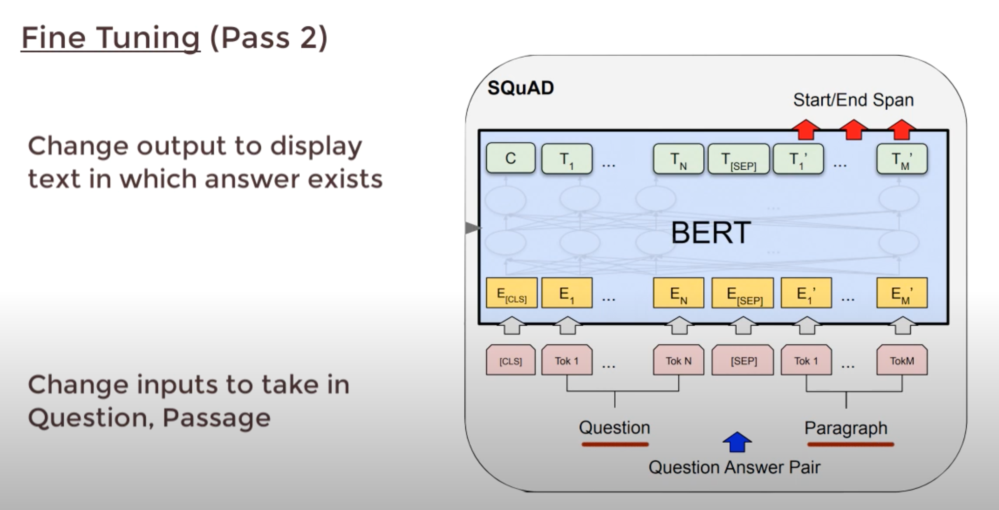
Fine Tuning

Slide 14
Notes
Character-level models, self-attention (Wang et al., 2017), and bi-attention (Seo et al., 2017)
Cross entropy

